Slide 1

by Keerthan P.V.

Slide 2
TEAM NAME : CommUnity QR
NAME: M NIRANJAN NAME: KEERTHAN P.V NAME: MANOJ R
SRN: PES2UG23CS308 SRN: PES2UG23CS272 SRN: PES2UG23CS328

Slide 3

Delivery Communication Platform: Bridging the Language Gap
A mobile-based delivery communication platform that leverages QR codes, language translation, and video/voice calls to enhance delivery efficiency and customer satisfaction, particularly for non-English speakers and those with security concerns.
by Keerthan P.V.

Slide 4

The Problem: Delivery challenges for non-English speakers and security concerns
1
Communication Barriers
2
Security Concerns
Delivery personnel often struggle to communicate with customers who don't speak English.
Customers may feel uneasy about accepting packages from strangers, particularly when they can't understand what's being said.
3
Delivery Delays
4
Customer Dissatisfaction
Misunderstandings and communication breakdowns can lead to delays and inaccurate deliveries.
Negative experiences can lead to low customer satisfaction, impacting brand reputation and loyalty.

Slide 5
Proposed Solution: QR code communication, language translation, and video/voice calls
QR Code Communication
Language Translation
Video/Voice Calls
Customers receive a unique QR code with their delivery information.
The platform translates messages in real-time, bridging language barriers.
Customers and delivery personnel can make video or voice calls for clearer communication.
Delivery personnel scan the code to initiate communication.
Customers and delivery personnel can communicate effectively, regardless of language.
This allows for visual confirmation of identity and package contents.

Slide 6
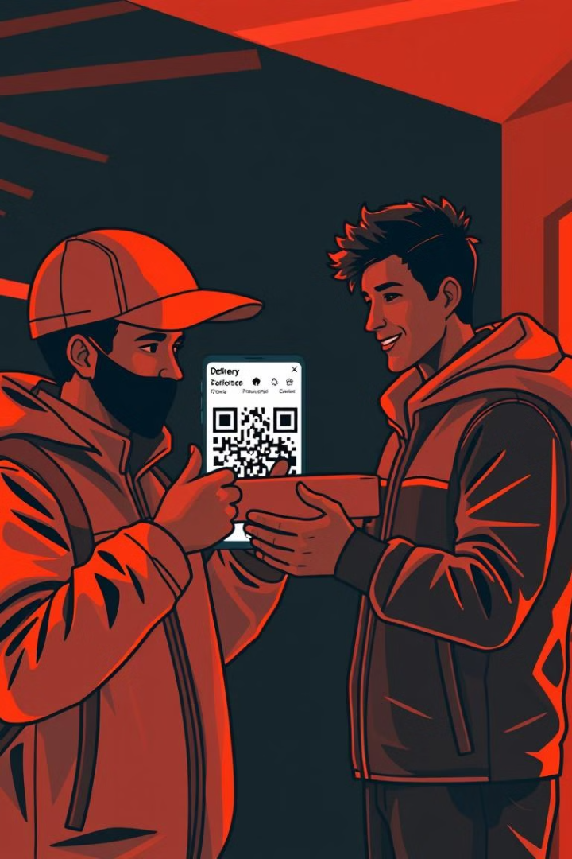




How it Works: Step-by-step customer and delivery person experience
Customer Receives Package
Customer receives a notification with a unique QR code for their delivery.
Driver Arrives at Location
Delivery driver scans the QR code at the customer's doorstep.
Communication Initiated
Communication channel opens, allowing for chat, voice call, or video call.
Delivery and Confirmation
Customer and delivery person confirm delivery details, address any questions, and complete the delivery.

Slide 7

Market Opportunity: Unmet needs in e-commerce and delivery services
E-commerce Growth
Rapid growth in online shopping creates demand for efficient delivery solutions.
Diverse Customer Base
Serving a diverse population requires multilingual communication capabilities.
Security Concerns
Increasing security concerns require improved communication and verification methods.

Slide 8
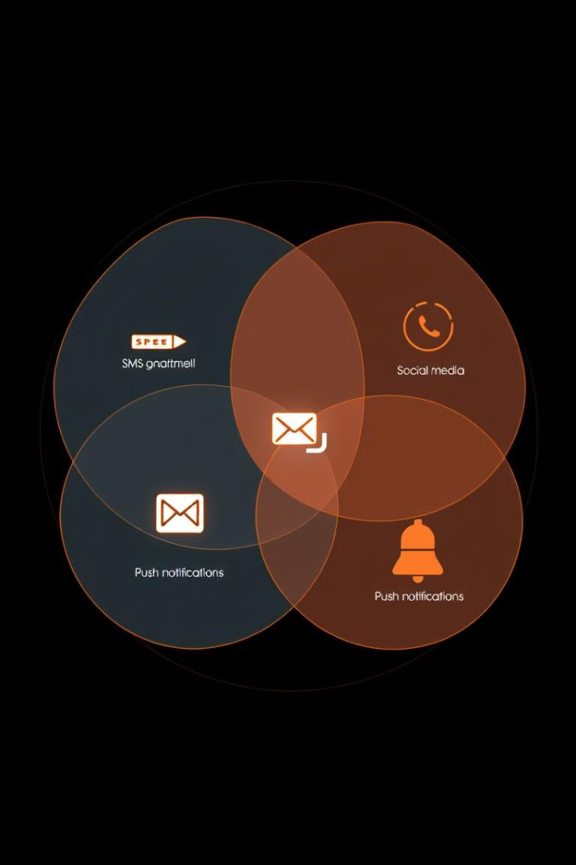
Competitive Landscape: Direct and indirect competitors
Direct Competitors
Indirect Competitors
Other delivery platforms offering communication features, such as chat or voice calls.
Translation services, security verification apps, and general communication platforms.
Differentiation
Focus on QR code integration, real-time language translation, and multi-modal communication.

Slide 9
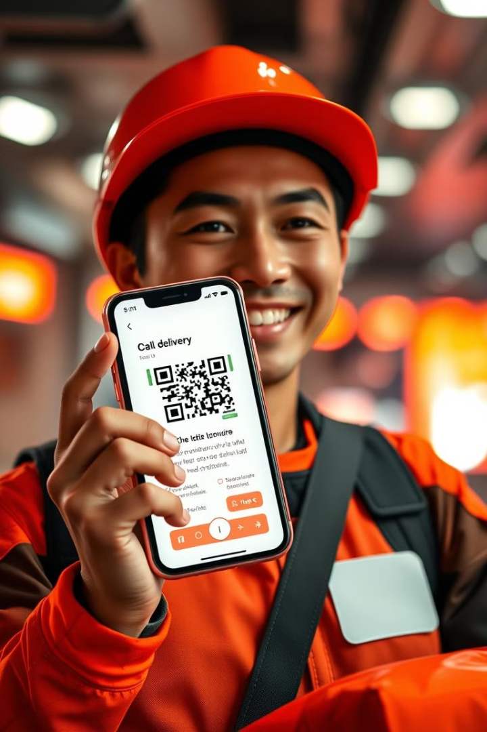




Advantages over Existing Solutions: Unique features and benefits
QR Code Integration
Real-time Language Translation
Seamless and efficient communication initiation.
Eliminates language barriers, improving customer experience.
Video/Voice Calls
Security Features
Enhanced communication clarity and security.
Increased safety and trust for both customers and delivery personnel.

Slide 10
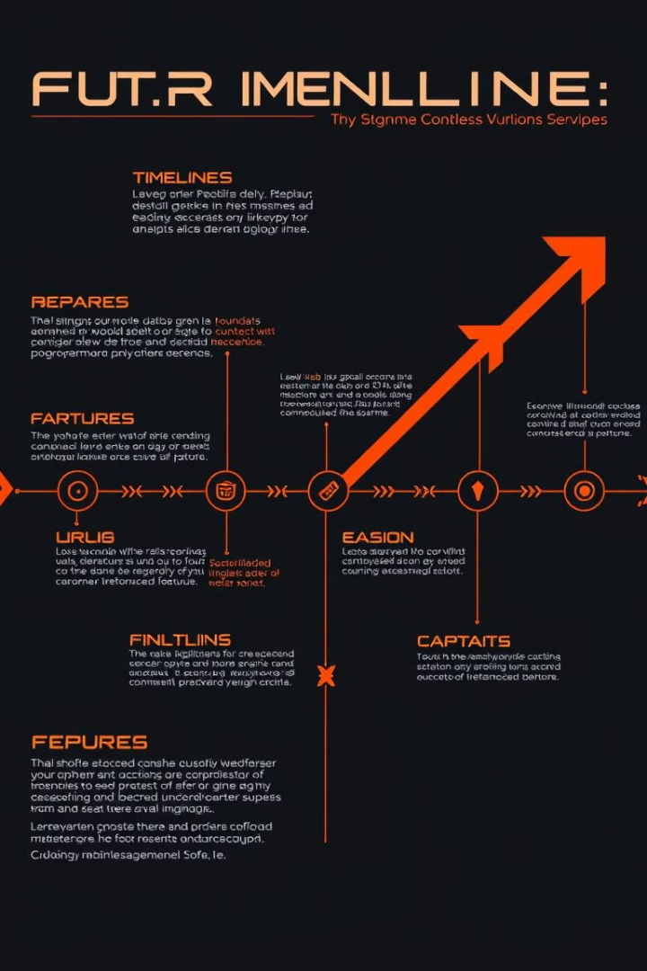
The Road Ahead: Future developments and growth plans
1
Expansion to New Markets
Target countries with high e-commerce adoption and diverse language populations.
2
Integration with Delivery Platforms
Partner with leading delivery companies to expand reach and user base.
3
Advanced Features
Develop AI-powered features for automated translation and personalized communication.
4
Data Analytics
Leverage data insights to optimize delivery routes, improve efficiency, and enhance customer service.

